Slide 1

EDGE AI SYSTEM
A technical overview of architecture, applications, and the future of on-device intelligence
PRESENTED BY
Name : Sk Arshad Basha
Reg no :192312336
01

Slide 2


What Is Edge AI?
Edge AI refers to running artificial intelligence algorithms directly on local hardware — sensors, cameras, gateways, or embedded Systems. It allows devices to analyze data and make decisions in real time, providing faster responses, lower latency, better privacy, and reduced internet bandwidth usage.
CLOUD AI vs EDGE AI
Processing location
Cloud: Remote data center
Edge: On the local device
On-device inference
Trained models run locally on the chip, not in a remote data center.
Latency
Cloud: Higher (network trip)
Edge: Very low (local)
No constant connectivity
Works fully or partially offline, unaffected by network drops.
Connectivity need
Cloud: Constant
Edge: Optional / intermittent
Real-time response
Decisions happen in milliseconds instead of round-tripping to the cloud.
Data privacy
Cloud: Data leaves device
Edge: Data can stay on device
02

Slide 3
Why Edge AI Matters
Moving inference closer to the data source solves problems cloud-only AI cannot.
<10ms
0
24/7
1/nth
Typical local inference latency, vs. 100ms+ round trips to the cloud
Bytes of raw data that must leave the device when inference is local
Operation continues even during network or connectivity outages
Bandwidth cost — only insights, not raw streams, are transmitted
03

Slide 4



System Architecture
Sensing
Edge Inference
Local Action
Cloud Synchronization
Cameras, microphones, and IoT sensors capture raw signals.
A compressed model runs on local silicon (NPU / MCU / GPU).
Filtered results trigger an immediate action or alert.
Only summarized insights or model updates sync upstream.
04

Slide 5


Core Hardware Components
NPUs & Edge GPUs
Local Storage
Dedicated silicon (Neural Processing Units, edge GPUs) accelerates matrix math for on-chip inference.
On-device flash or SSD caches models, buffered data, and logs for offline operation.
Sensors & Actuators
Low-Power MCUs
Cameras, microphones, and industrial sensors feed raw signals directly into the pipeline.
Microcontrollers running TinyML models operate on milliwatts for battery-powered devices.
05

Slide 6




Applications Across Industries
Autonomous Vehicles
Healthcare Monitoring
Smart Surveillance
Real-time object detection and path planning without cloud latency.
Wearables detect anomalies (e.g., arrhythmias) instantly, on-body.
Cameras flag events locally, sending only relevant clips upstream.
Industrial Automation
Retail & Security
Smart Agriculture
Factory sensors predict equipment failure before it happens.
In-store analytics and access control run without exposing footage.
Field sensors optimize irrigation and detect crop stress on-site.
07

Slide 7




Key Benefits
Ultra-low latency
RESPONSE TIME COMPARISON
Milliseconds, not seconds — critical for safety systems.
Stronger privacy
Sensitive data (faces, health signals) never has to leave the device.
Offline resilience
Keeps working through network outages or in remote areas.
Lower bandwidth cost
Only compact insights are transmitted, not raw video/audio streams.
08

Slide 8
CONCLUSION
Edge AI enables fast, secure, and real-time data processing by running AI models locally on edge devices, reducing latency, bandwidth usage, and dependence on cloud services.
It is a reliable and efficient technology for applications such as smart surveillance, healthcare, agriculture, robotics, industrial automation, and smart homes.
It improves system reliability by allowing devices to make decisions locally, even when internet connectivity is limited or unavailable.
Edge AI provides a scalable foundation for future intelligent systems by combining machine learning with efficient edge computing technologies.

Slide 9
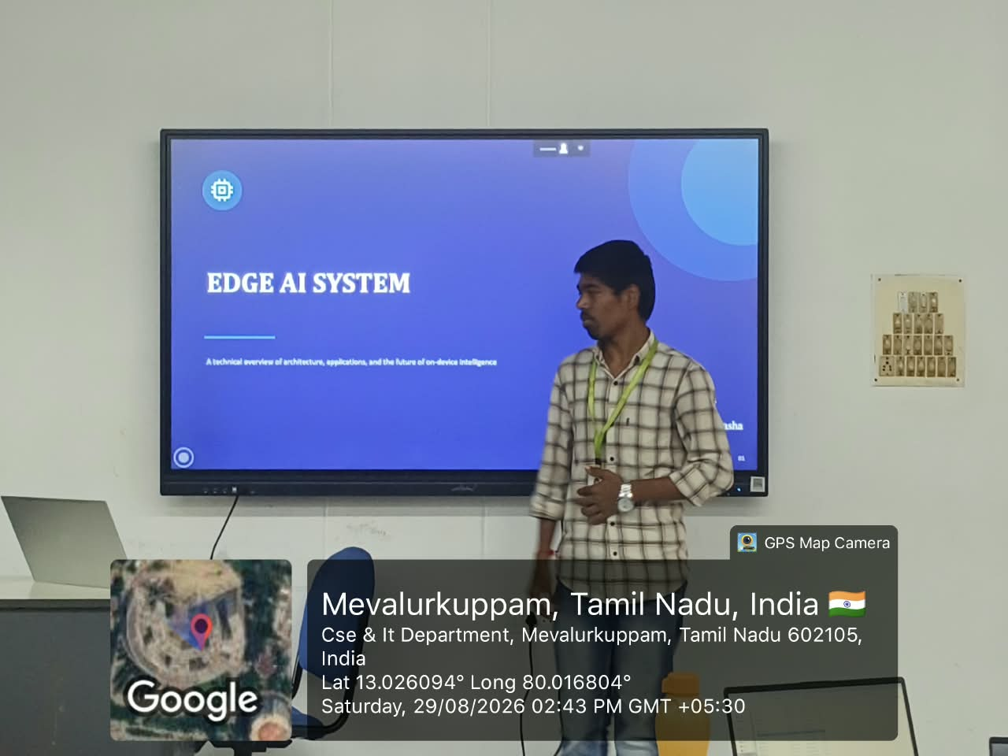
GEO TAG PHOTO

Slide 10


